Slide 1
Twitter Sentiment Analysis
Arushi Sabharwal - W1468298 Jay Shah - W1463785
Srusti Shah - W1471910 Lidia Tolbuzova - W1468230
COEN 281 - Pattern Recognition and Data Mining

Slide 2

Motivation:
NLP Sentiment Analysis - Social Media Monitoring, gain public opinion on important topics (Adopted by Organizations on a world-wide scale)
Correlation to shifts in Stock Markets, Market Research and getting opinion of new products/services as well as competitors
Example: Tormented Tweets led to Tweaking Creativity-Expedia Canada took advantage of negative consumer attitude as a feedback to the music used in one of their television advertisement
Keeping in mind, how popular Social Media platforms are - Twitter is one of the best means to learn what matters the most!

Slide 3
Problem Definition:
Objective: To classify a tweet as a Positive or Negative Sentiment based on it’s content
Machine Learning Algorithms used:
Naive Bayes Method
Logistic Regression
Random Forest
Support Vector Machines (SVM)
Linear Regression
Evaluation of the Algorithms and figure out which one works best!

Slide 4
Data Set and Data Cleaning:
Data Source: http://cs.stanford.edu/people/alecmgo/trainingandtestdata.zip
Date Description:
Dataset file format- CSV file with labeled data
Dataset Size - 84 Mb
Number of Data Points - 1,600,000
Number of Attributes - 6 (“tweet id”, “date time”, “query” , “user”, “label”, “tweet”)
Dropped Attributes - “tweet id”, “date time”, “query” , and “user”
Data Cleaning: twitter handles, url links, #, lower case, numbers, punctuation, tokenization, lemmatization
After Cleaning: 3959 values were NULL, so we removed them; Left with almost equal number of negative and positive tweets (798197 and 797844)

Slide 5
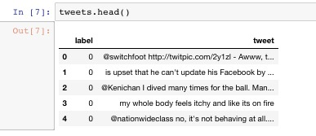
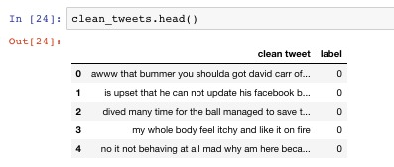
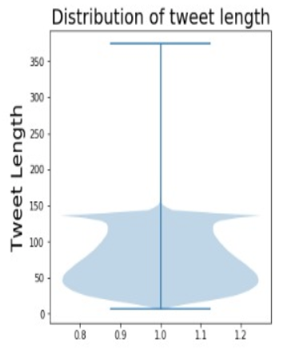
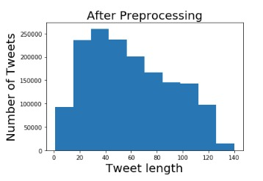
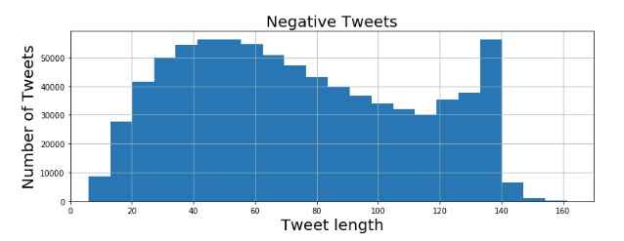
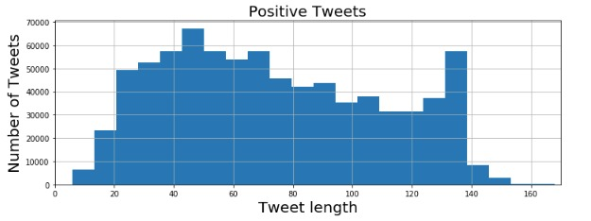
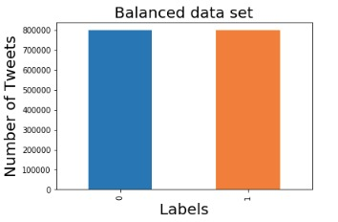
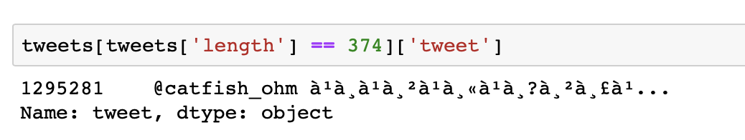
Data Preprocessing:

Slide 6
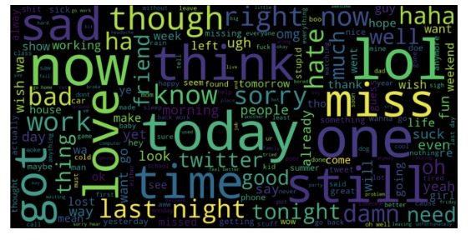
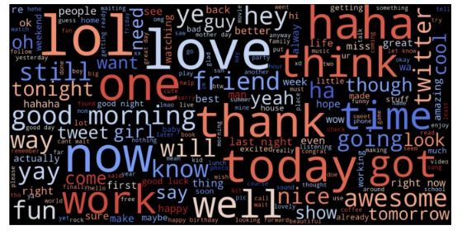
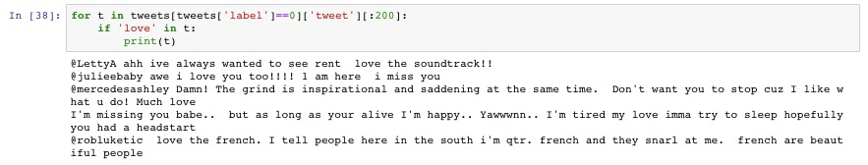
EDA: WordCloud
Negative Tweets
Positive Tweets
Sarcastic or Sad Manner!

Slide 7
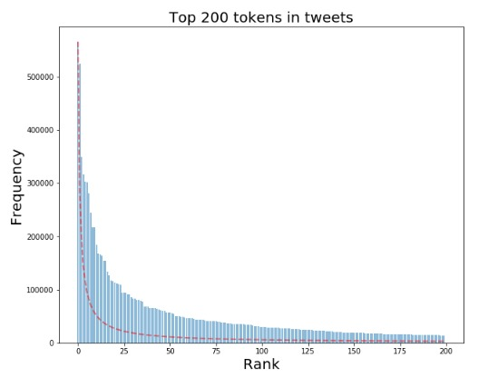
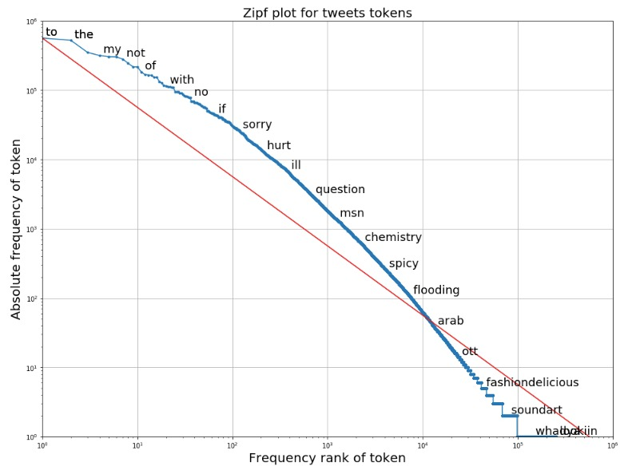
EDA: Zipf’s Law

Slide 8
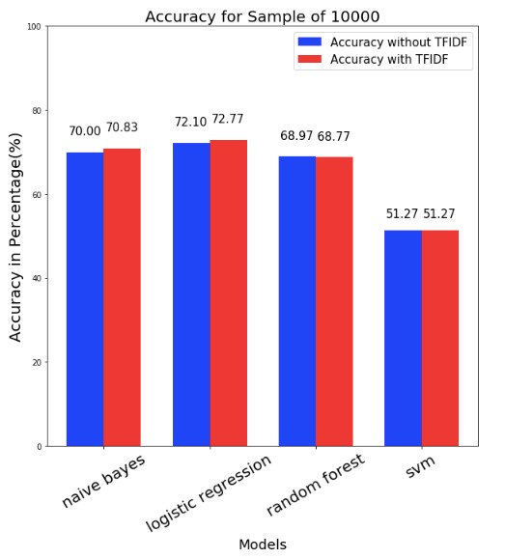
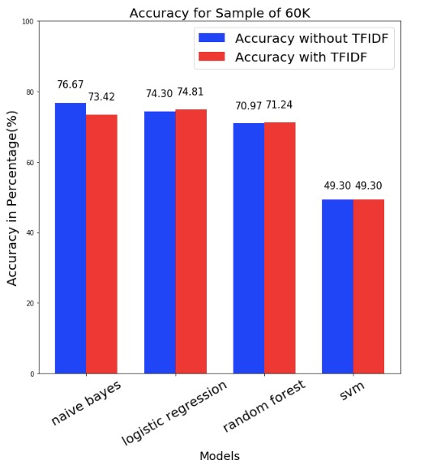
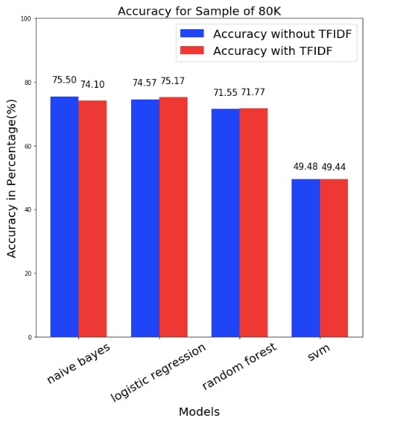
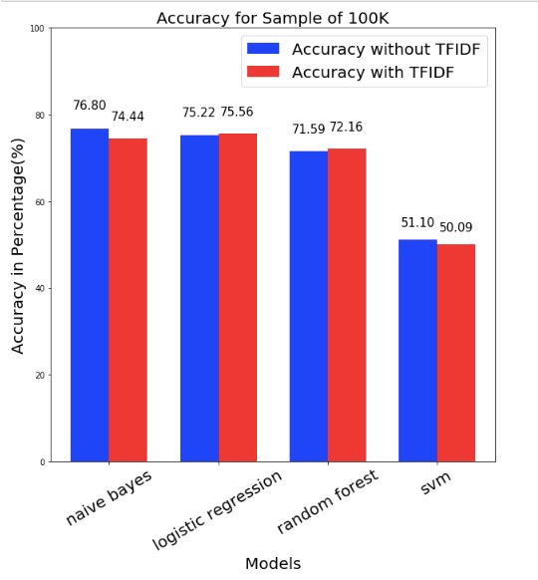
Model Evaluation: Accuracy
Sample: 10,000
Sample: 60,000
Sample: 80,000
Sample: 100,000
Maximum Features: 10,000

Slide 9
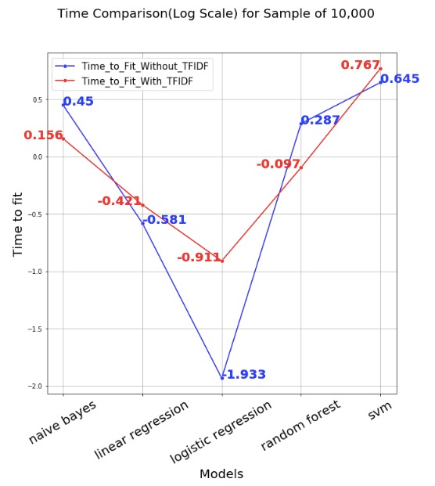
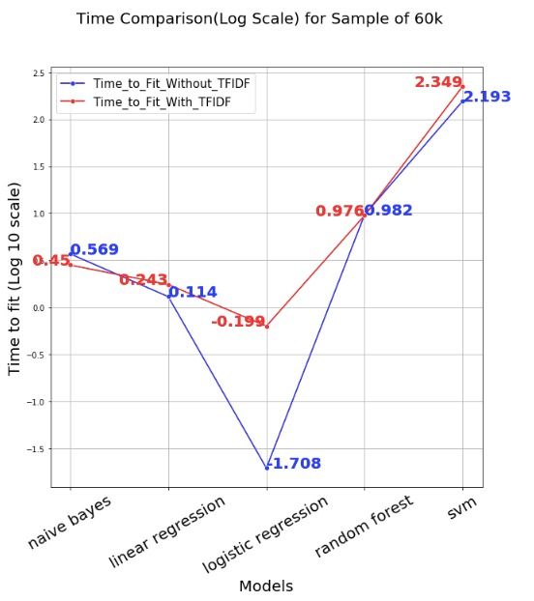
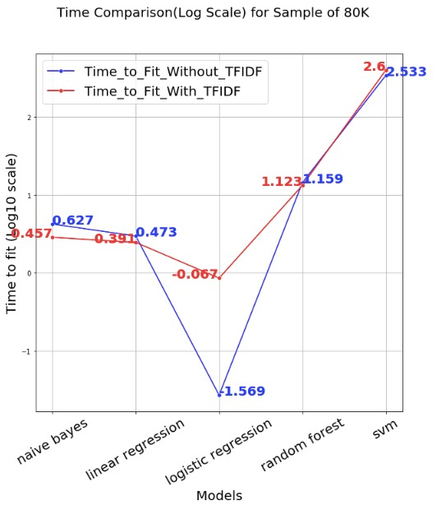
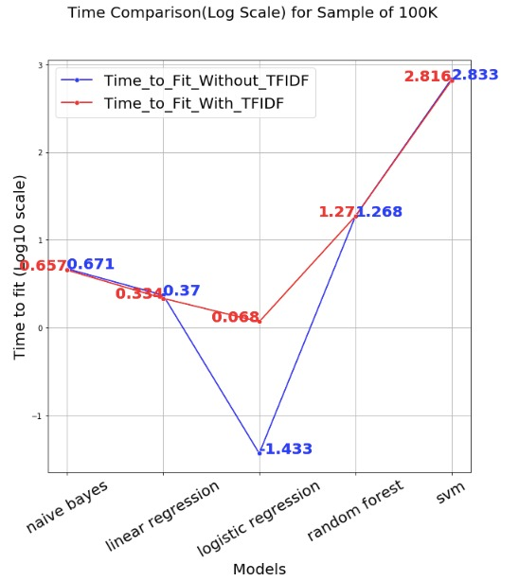
Model Evaluation: Time to Fit
Sample: 10,000
Sample: 60,000
Sample: 80,000
Sample: 100,000
Maximum Features: 10,000

Slide 10
Challenges & Conclusion:
Sample the Original Dataset - Huge
In some Samples, the accuracies with tf-idf was lower than without, in contrast to our expectations - for Naive Bayes and Random Forest.
Reason - Tweets are general, have no common context?
Plotting the model fit time in a Log10 scale, as the values were skewed.
Logistic Regression and Naïve Bayes are the most suited classifiers for our dataset, with Logistic Regression taking the lead because it takes very less time to fit, easily scalable
Performance of SVM was worse or similar to a Null Accuracy model’s (Dumb Model - classifies based on the high probabilistic class) performance which shows that it is not the best classifier for our dataset
Earlier decided to go upto 150,000 data points, but it was taking too much time as SVM is not at all scalable!

Slide 11

Reference for the image : https://www.google.com/search?q=twitter+sentiment+analysis+ppt&rlz=1C1GCEA_enUS807US807&source=lnms&tbm=isch&sa=X&ved=0ahUKEwiAxuz_svreAhVnh1QKHQvcCY4Q_AUIDigB&biw=1920&bih=969#imgrc=VcV_xL6tjncb2M:

